Slide 1
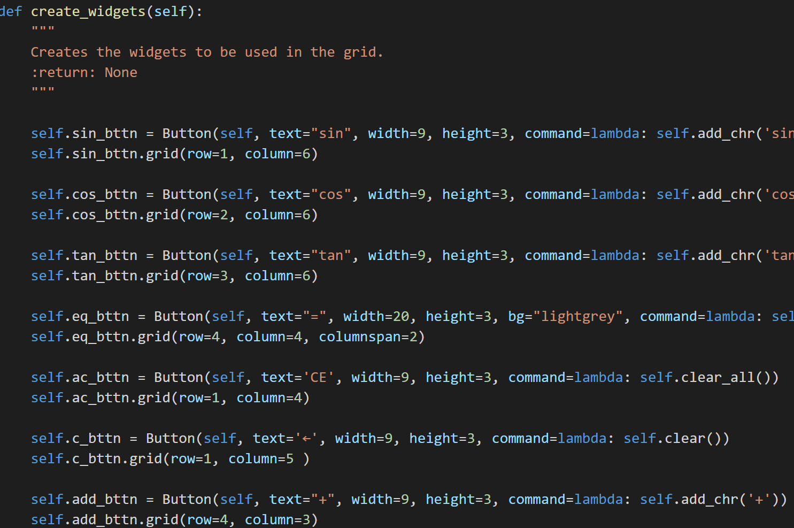
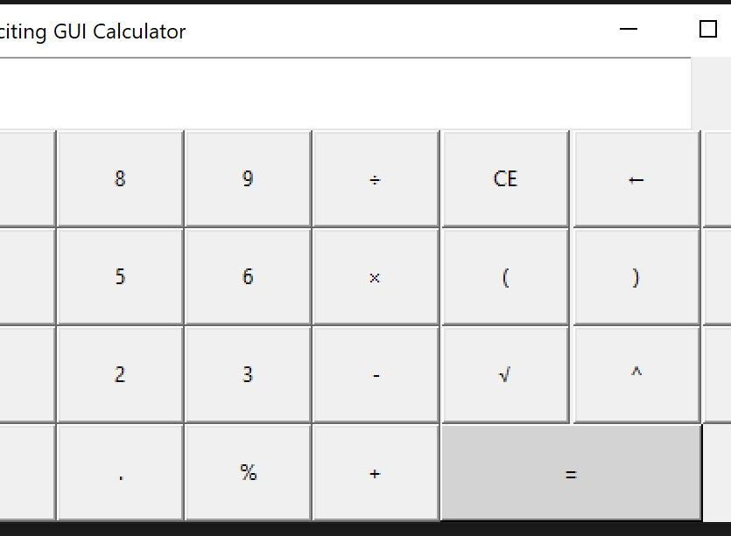
GUI Calculator
A fun app to modify a calculator using Tkinter
Coders: Brian Jones and Laquisha Adkins
https://github.com/ksu-is/GUI-Calculator

